Slide 1


Evelyn’s Recipe Book
By: Evelyn Marcott

Slide 2
Table of Contents
Meals:
-Israeli Salad; pg. 4
-Unfettered Frittatas; pg. 6
-Pasta Pomodora; pg. 8
-Middle Eastern Shakshuka; pg. 10
-Pancakes not from a Box; pg. 12
-Couscous Salad; pg. 14
-Siwar’s Potato Balls; pg. 16
-Stir Fry; pg. 18
-Jane’s Fish Salad; pg. 20
-Nacho’s Empanadas; pg. 22
Appetizers:
-Giulia’ Cheese Sticks; pg. 25
Desserts:
-Antidepressant Brownies; pg. 28
-Giulia’s Coconut Cookies; pg. 30
-Nutella Cake; pg. 32
-Yahli’s Hamantaschen; pg. 34
-Uriel’s Sweet Rice; pg. 36
-Tal’s Cinnamon Rolls; pg. 38
-Evelyn’s Blondies; pg. 40
-Kzenia’s Chocolate Potatoes; pg. 42
-Csongor’s Black-and-White Cupcakes; pg. 44

Slide 3
Meals

Slide 4
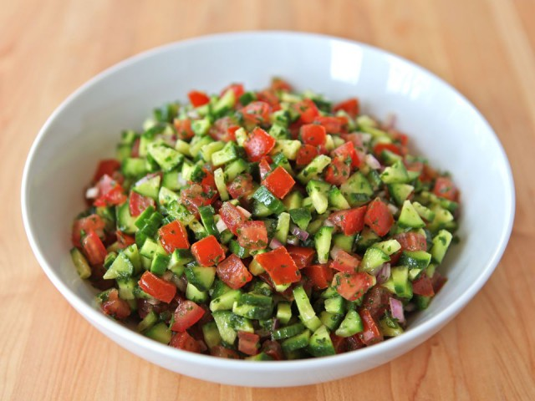
Israeli Salad

Slide 5
Ingredients:
2 tomatoes
3 cucumbers
1 spring onions
½ spanish onion
½ lemon
1-2 tbsp olive oil
sprig parsley
salt & peper
Method:
Wash cucumbers, onion, tomatoes, and parsley
Cut into very small cubes/pieces (spring onion in rings)
Cut parsley (chop thinly)
Season with lemon, oil, salt & pepper

Slide 6
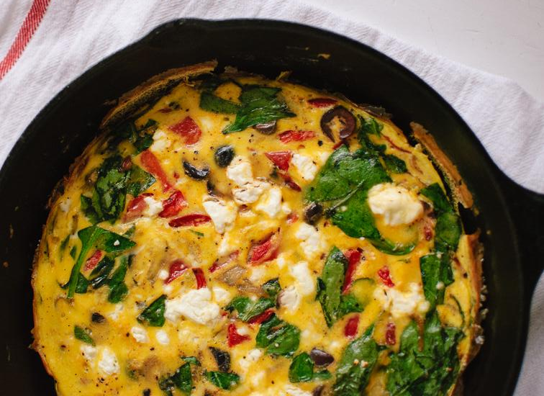
Unfettered Frittatas

Slide 7
Ingredients:
1 tbsp olive oil
½ medium spanish onion chopped
½ zucchini chopped
sliced mushroom
sliced red pepper
spinach
2 eggs beaten
1 tbsp grated parmesan cheese
2 ml salt
pinch of pepper
zarta (optional)
1 tbsp butter or olive oil
Method:
Heat olive oil in pan
Add sliced onions in and saute till soft
Throw in whatever vegetables you have (Save spinach for last!!!)
Cook them with onions; stir occasionally
Remove the pan from the heat
In a bowl add your eggs and beat them with some cheese, salt, pepper, and other herbs (zarta)
Add vegetables to egg mixture; stir in to mix
In pan melt butter or olive oil
If using butter wait till the butter is foamy and then pour mixture in and set on low heat
Cook for about 15-20 minutes (uncovered)
When almost set, sprinkle some cheese on it and set it under the broyal (until brown)

Slide 8
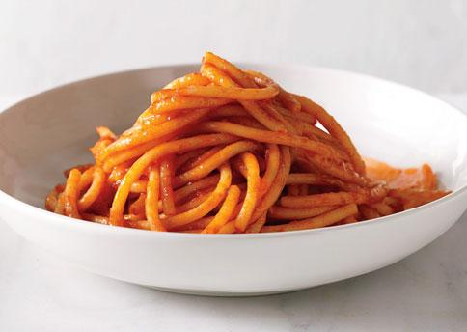
Pasta Pomodora

Slide 9
Ingredients:
1 tbsp olive oil
½ spanish onion chopped
2 garlic cloves; peeled and chopped fine
½ can Italian chopped tomatoes
1 tsp tomato paste
½ tsp salt
¼ tsp pepper
1 tbsp pesto
paramassion cheese
Method for Pasta:
In your largest pot boil water and add 1 tsp salt
Throw in your pasta and keep on boil without the lid on for about 5-8 minutes
Test Pasta when you think it is ready
Method for Sauce:
In a pan heat the olive oil
Saute onions for about 3-5 minutes
Add chopped garlic; continue to saute
Add chopped tomatoes, paste, salt, and pepper; stir and then simmer on low heat
When the sauce is thick enough add your pesto; mix it through
Then mix the sauce with the pasta
Sprinkle cheese on top (not required)!

Slide 10
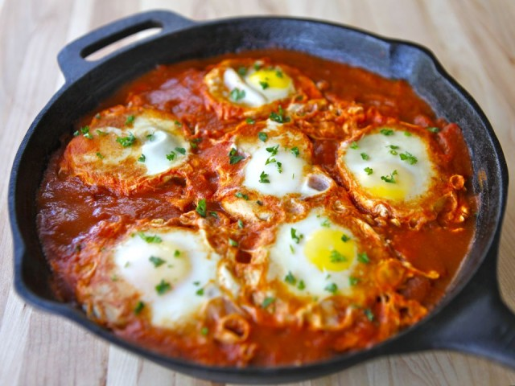
Middle Eastern Shakshuka

Slide 11
Ingredients:
1 tbsp olive oil
½ medium onion chopped
1-2 cloves garlic; very finely chopped
1 tsp smoked paprika
½ tsp cumin
½ can of Italian chopped tomatoes (or fresh tomatoes)
1 tbsp of water (if needed)
1 pinch of salt
1 pinch of pepper
1 egg
¼ cup of crumbled feta cheese
about 1 ½ tbsp cilentro or parsley
*Can eat with bread
Method:
Heat oil in a pan at medium to low heat
Add onions; saute for about 5 min or till soft
Add garlic, paprika, and cumin
Continue cooking for about 2 minutes
Add tomatoes, salt, pepper, water, and stir occasionally
Crack egg into a small bowl; be careful not to break the yoke
With the back of a spoon make a hollow hole in the middle of the sauce
Put yoke in the hollow (don’t break yoke)
Cover the pan with foil and let it cook for 5-6 minutes; basting the eggs once or twice so it sets
Sprinkle cheese and/or cilentro/parsley on sauce; cook for 1 minute

Slide 12
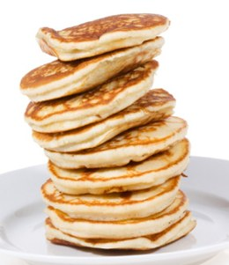
Pancakes not from a Box

Slide 13
Ingredients:
1 cup self raising flour
1 tbsp sugar
1 egg
1 cup milk
1 tsp olive oil; additional if needed
pinch of salt
Method:
In a medium bowl, stir the flour and sugar, then add the oil and salt
In a different bowl add the egg, milk and beat them together
Wisk both the wet and dry ingredients together
Put a small amount of oil into the pan (when you add 1 drop of water in it and it sizels then it is ready to cook with)
Add mixture; ¼ cup of batter per pancake
Allow pancakes to cook on one side, when the pancake bubbles on top flip it then wait a while to take it off
Serve with toppings of your choice

Slide 14
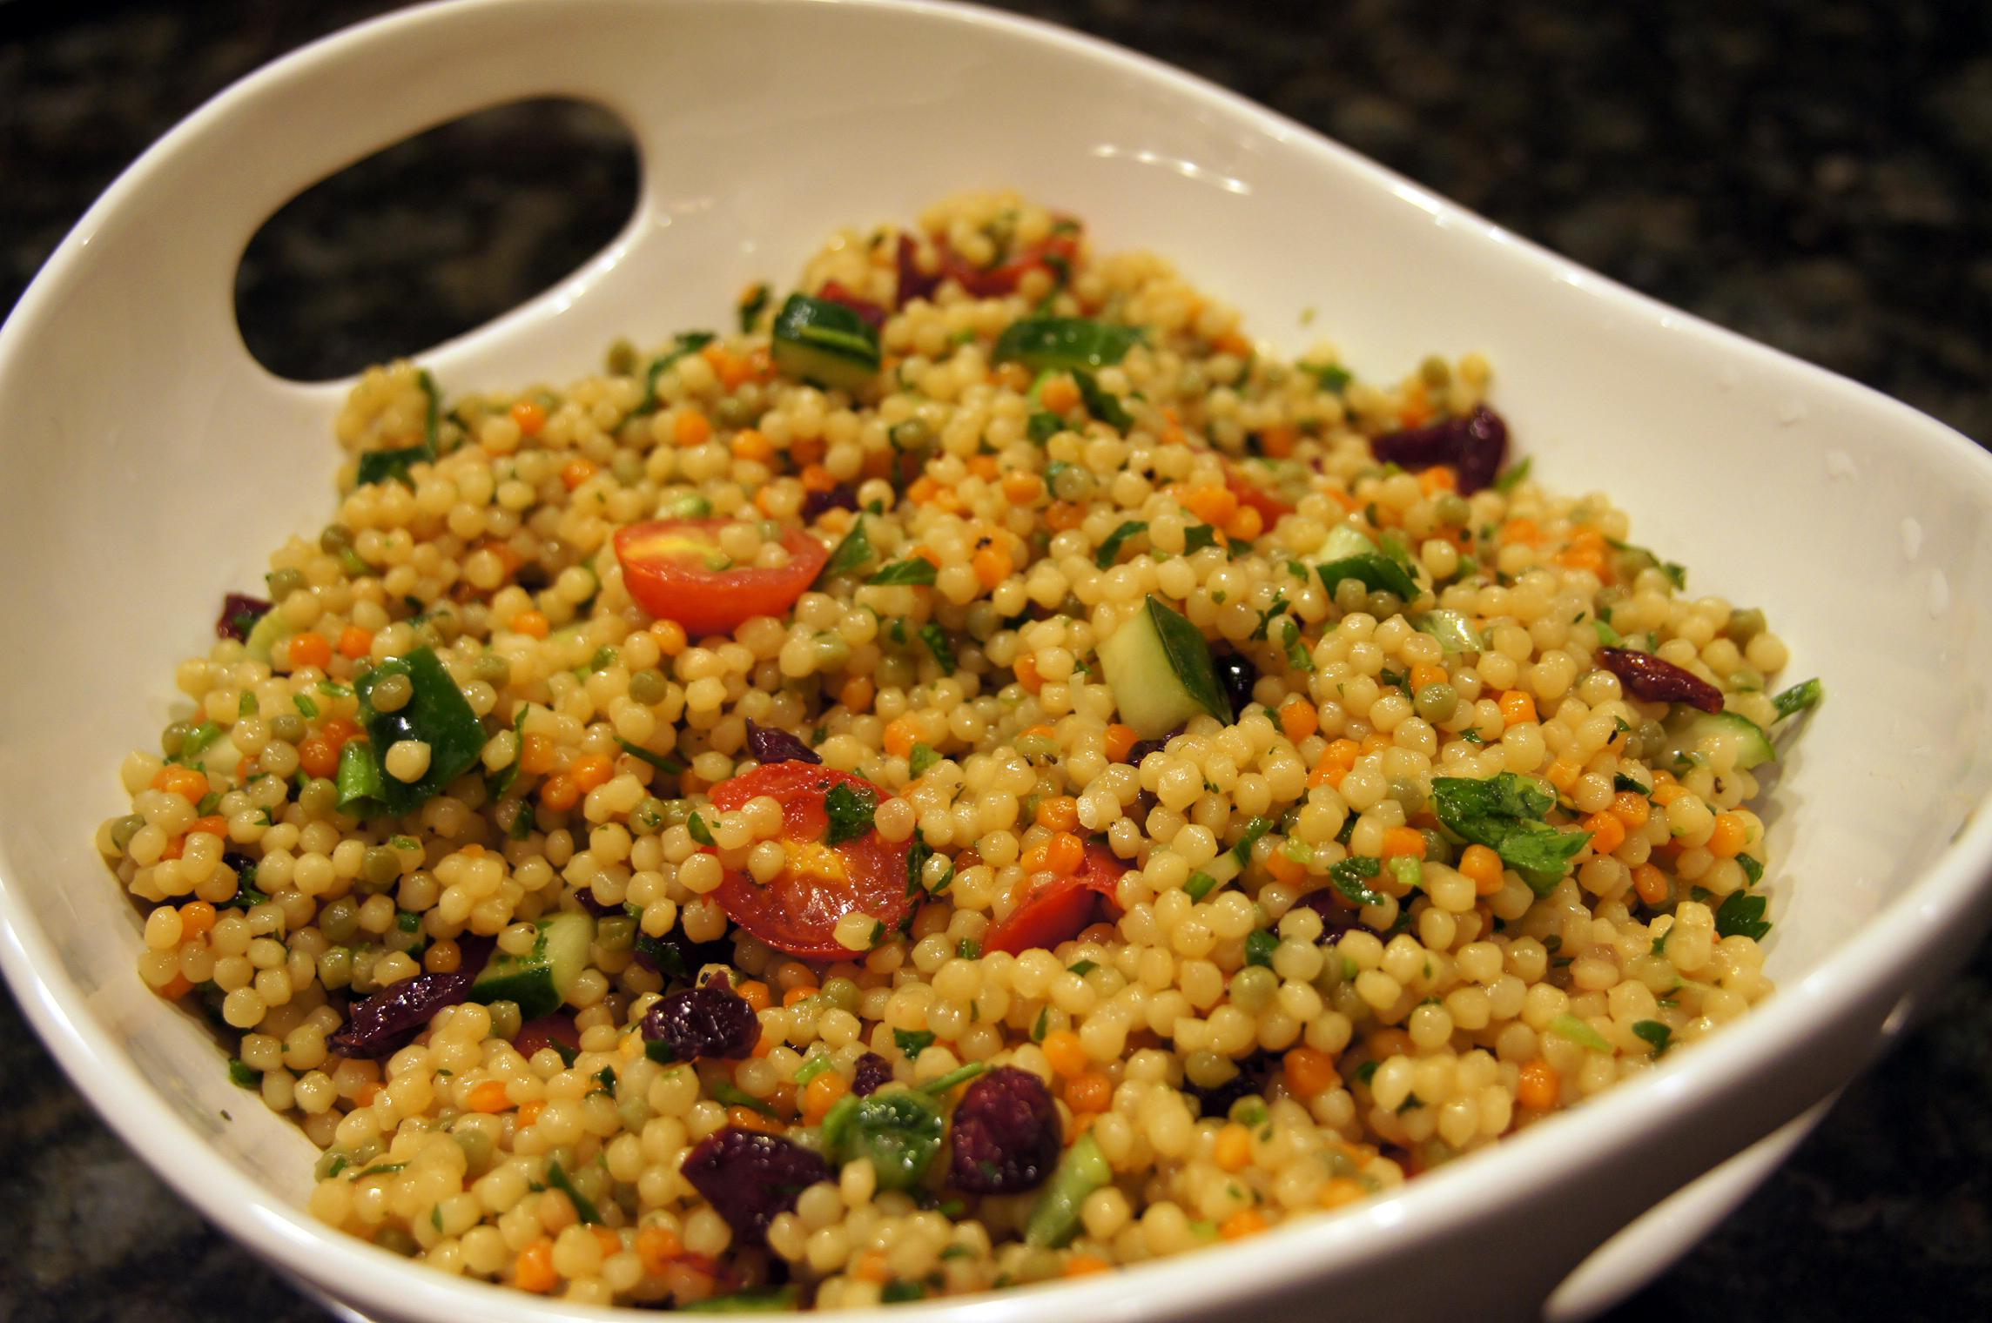
Couscous Salad

Slide 15
Ingredients:
½ cup water/broth
½ cup couscous
1 tbsp olive oil
1 ml salt
1-2 spring onion chopped
4 black olives chopped
¼ spanish onions chopped
¼ avocato
2-3 sun dried tomatoes
some parsley leaves or cusbara
¼ cup fetta cheese
1-2 tbsp lemon juice
1-2 tbsp roasted almonds
Method:
Prepare all vegetables
Add ½ the olive oil to the uncooked couscous
Pour water/broth into the bowl with couscous
Cover for about 4 minutes or until all the liquid is absorbed
Fluff with a fork
Add the salt and pepper
Add roasted almonds on top

Slide 16
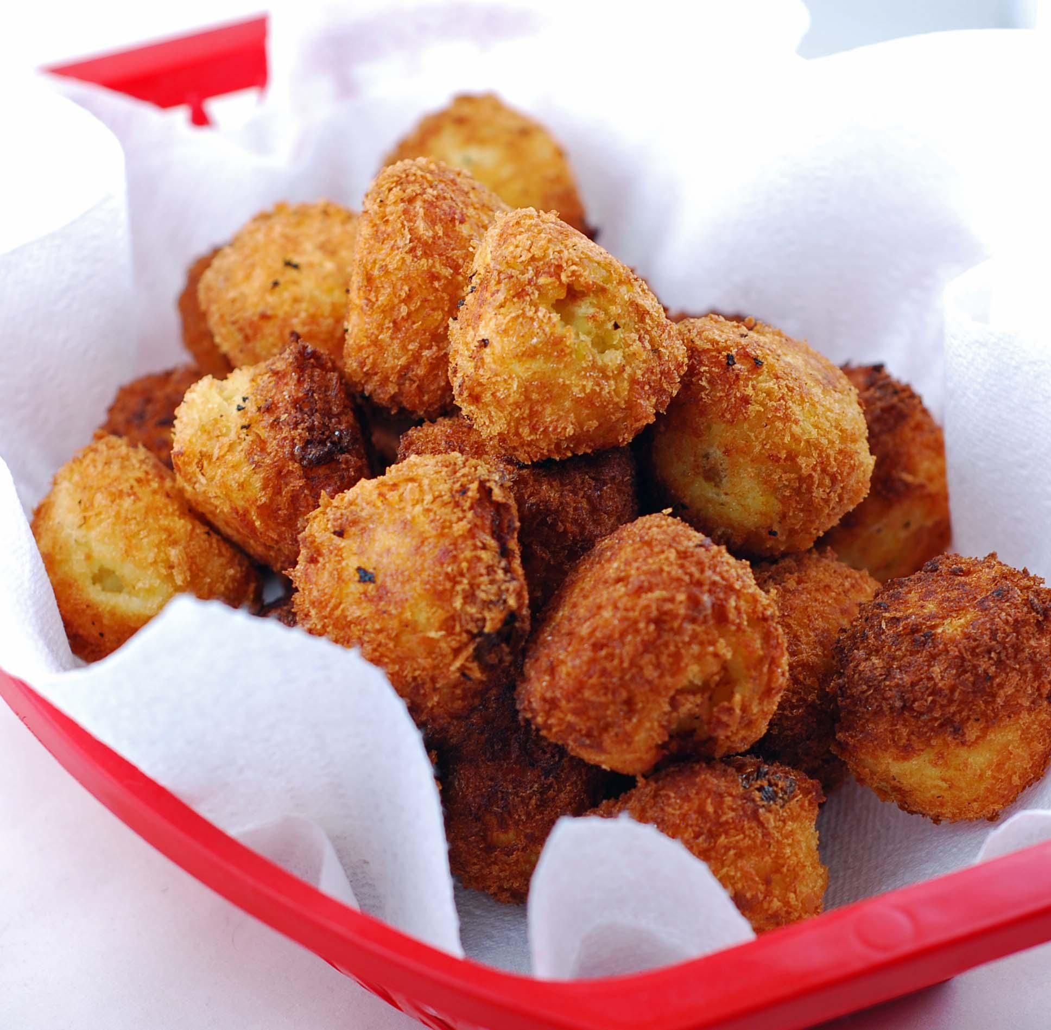
Siwar’s Potato Balls

Slide 17
Ingredients:
1 large potato
1 egg
1 tbsp flour
bread crumbs
oil
Method:
Pill a pot with water and add the potatoes in it; boil for 1 hour
Peel the potatoes
Put the potatoes in a bowl and mash them till there aren’t any crumbs left
Fill the pan halfway, with oil and heat it
Add the egg white to the mashed potatoes
Add the flour to the mashed potatoes
Then mix till smooth consistency
Make the mixture into balls
In another bowl wisk the egg yoke
Cover the potato balls with the egg yoke
Then roll it in the bread crumbs
Put in pan with the oil; wait till it is brown-goldish on the outside to take it out

Slide 18
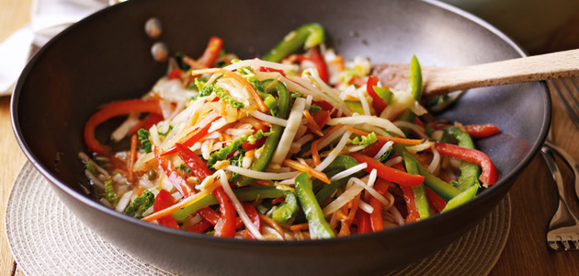
Stir Fry

Slide 19
Ingredients:
1 tbsp olive oil
1 bunch of broccoli floures
½ red pepper
1 clove of garlic
1-2 green onions
1 tsp sesame oil
1 tbsp soy/teriyaki sauce
2 tbsp crushed cashews (optional)
½ zucchini
Method:
Arrange all of the cut vegetable on your cooking mat (all vegetables separate)
Add sesame oil and soy/teriyaki sauce in a bowl
Put about ½ tbsp olive oil in a pan on medium heat
After 2 minutes add the broccoli, red pepper, zucchini, and garlic; stir fry for about 1-2 minutes
Add the green onions after 2 minutes
Cover to let it steam for a few minutes
Add the wet ingredients and the cashes to the stir fry at the end

Slide 20
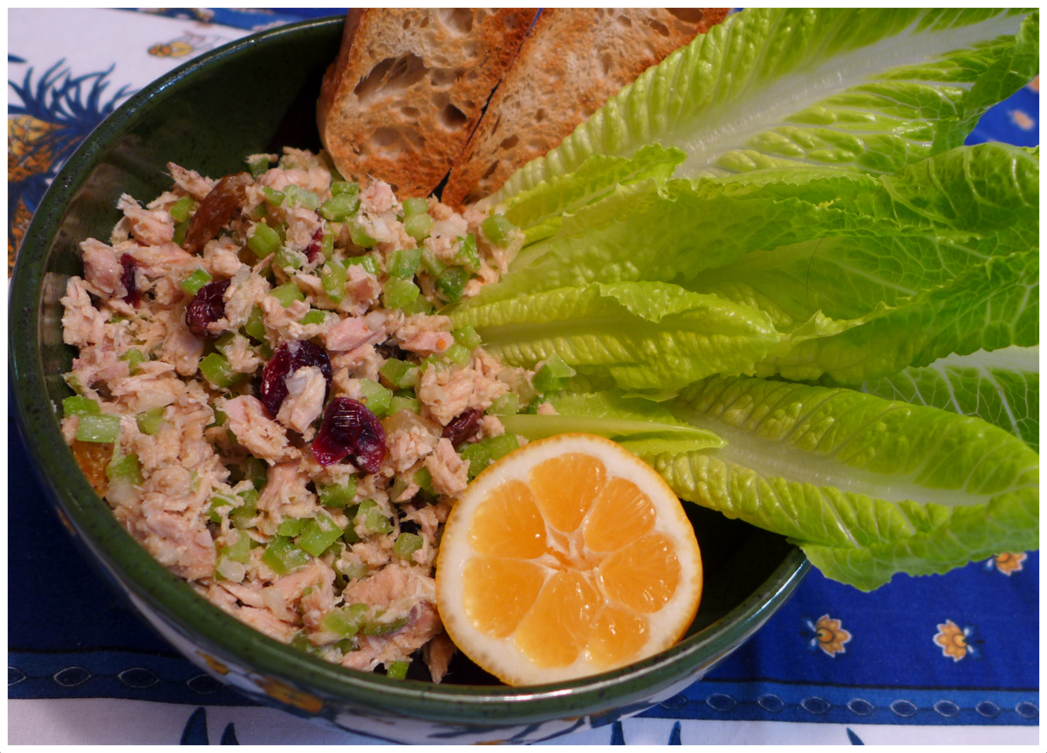
Jane’s Fish Salad

Slide 21
Ingredients:
2 boiled eggs
½ can salmon
50 ml rice
½ can corn
½ small white onion
mayonnaise
salt & pepper
Method:
Cook the eggs and rice (not together)
Mash the salmon in a bowl
Cut the onion into small pieces
Cut the eggs, the same size as the onions
Put the onions and eggs in the bowl with the salmon
Then add the rice and corn
Then add the mayonnaise, salt & pepper in the bowl

Slide 22
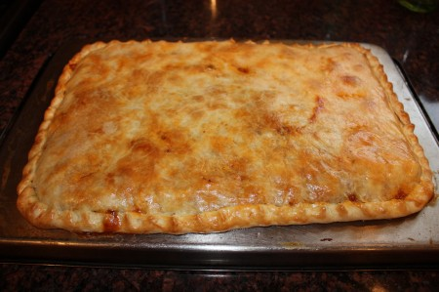
Nacho’s Empanadas

Slide 23
Method:
Preheat oven to 180˚C
Divide Puff Pastry into half (2 equal pieces)
Take both slices and stretch them with a roller
Add tomato sauce on ONE of the pieces of pastry
Lay down the turkey slices and then the cheese slices
Sprinkle the grated cheese on top and then sprinkle the oregano on top
Take the second piece of pastry and put in on top of the first piece with all the stuff on top of it
Close the borders and bathe the surface of the pastry with olive oil
Put it in the oven for 35 minutes or until it is brown-goldenish on the surface
Once taken out let it rest for 5-10 minutes
Ingredients:
500 grams of Puff Pastry
150 grams of sliced turkey
200 grams of sliced cheese
100 grams of grated cheese
6 tbsp of tomato sauce
pinch of oregano
olive oil

Slide 24
Appetizers

Slide 25
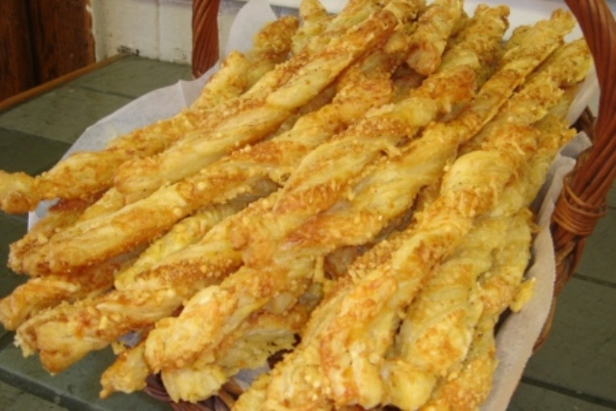
Giulia’s Cheese Sticks

Slide 26
Ingredients:
Puff Pastry
Cheese
1 egg yoke
sesame seeds
pinch of salt
Method:
Take the puff pastry and roll it out
Spread the egg yoke on it with a brush (anything that will make it shine)
Sprinkle the cheese, sesame seeds, and salt on top
Cut in strips with a knife (the puff pastry)
Then twist it
Put it in the oven for 8 minutes at 200˚C

Slide 27
Desserts

Slide 28
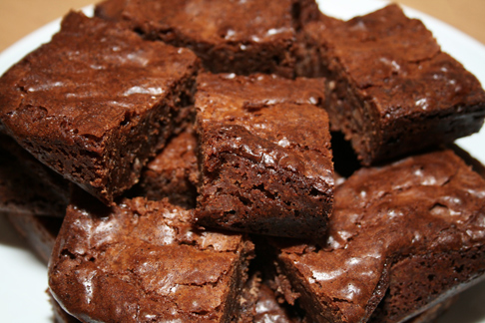
Antidepressant Brownies

Slide 29
Ingredients:
1⅓ cup of chocolate chips
2 eggs
⅔ cup of sugar
⅓ cup butter
2 tbsp water
¾ cup all purpose flour
½ tsp baking powder
½ tsp vanilla extract
Method:
Preheat oven to 180˚C
Grease pan with butter foil
In a medium sauce pan combine chocolate chips, butter, sugar, and water
Stir constantly; stir till mixture is smooth, melted
Remove from heat; cool mixture
Add eggs; wisk till smooth
Dump in the flour, baking powder, and vanilla; stir until all the ingredients are mixed
Pour into your baking pan; bake for about 20 minutes
Bake until when a stick is inserted it comes out nearly clean

Slide 30
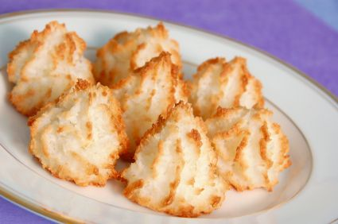
Giulia’s Coconut Cookies

Slide 31
Ingredients:
50 grams of coconut
1 egg (white part only)
50 grams of sugar
50 grams of chocolate chips
Method:
Mix all the ingredients together with your hands
Create small balls and put them on your baking tray
Put it in the oven for 10 minutes at 200˚C

Slide 32
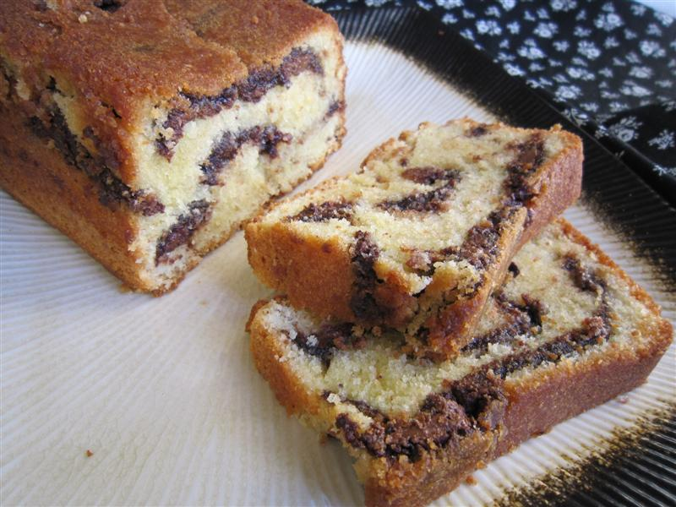
Nutella Cake

Slide 33
Ingredients:
125 ml whipping cream
1 egg
100 ml sugar
½ cup self raising flour
2 tbsp nutella
Method:
Preheat the oven to 160˚C
Grease pan (butter or veggie oil)
Mix the whipping cream with the sugar and egg; mix for about 3-5 minutes or till thicken
Add flour; mix into smooth batter
Put ⅔ of the batter into foil pan and leave the other ⅓ in the bowl
Mix the nutella into the ⅓ of batter until brown
Add the brown mixture to the baking pan
Take a fork and mix the brown and white together to make a marble affect
Bake for about 40-45 minutes or until a toothpick inserted comes out cleanish

Slide 34
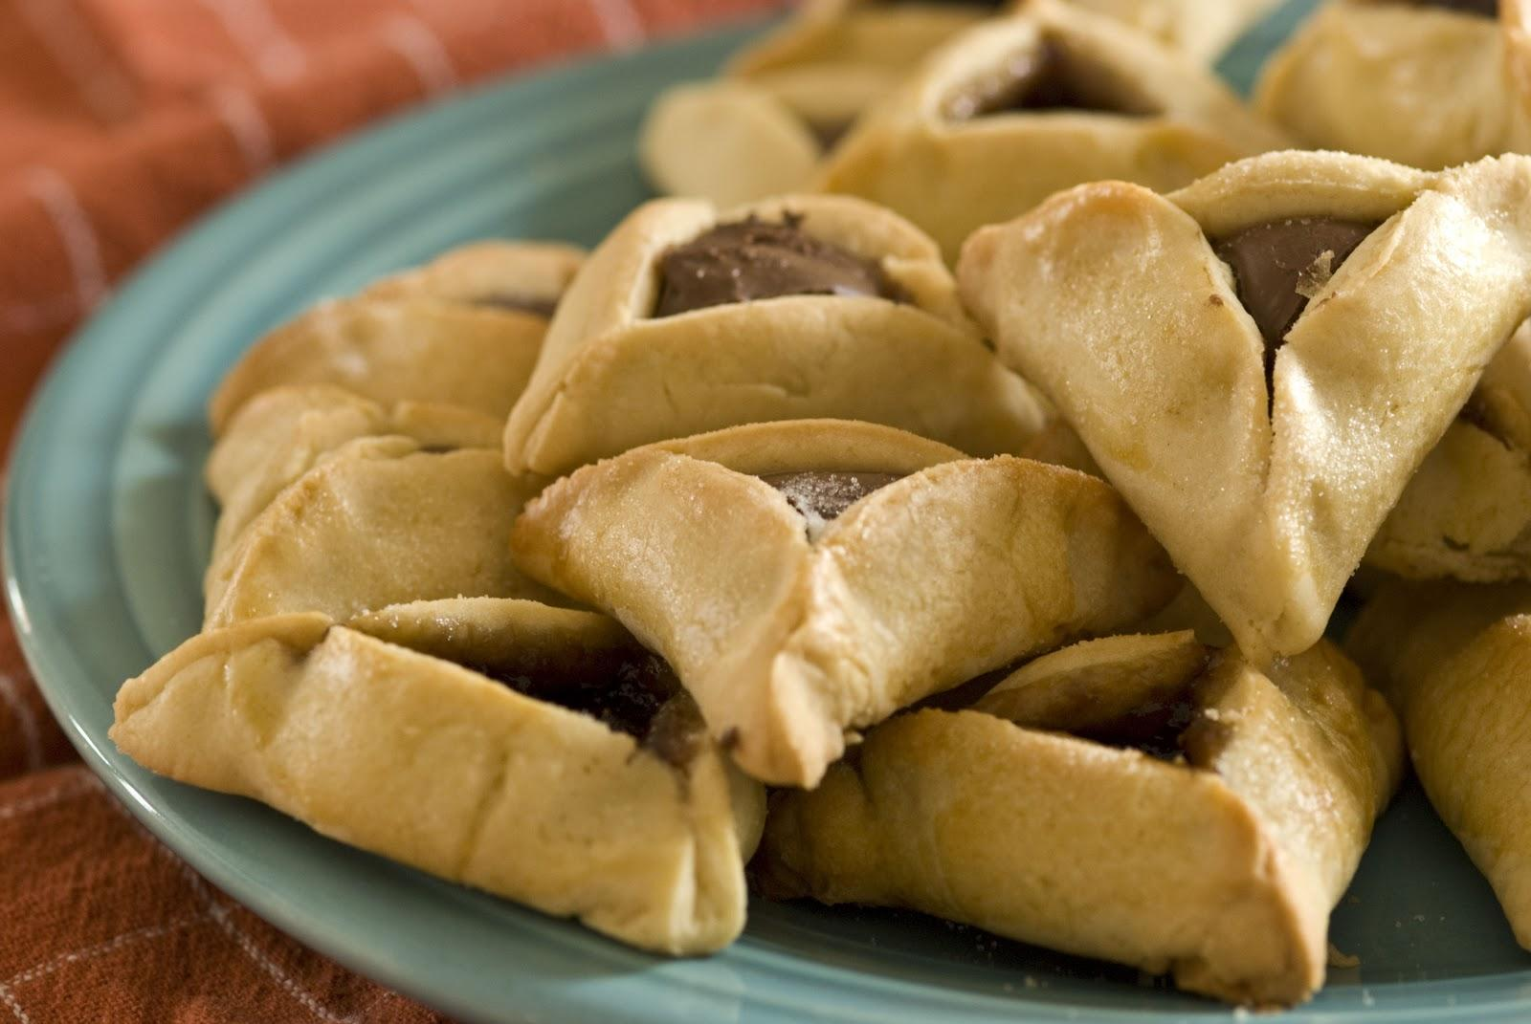
Yahli’s Hamantaschen

Slide 35
Ingredients: *(For the dough)
300 grams of flour
75 grams of almond powder
75 grams of powder sugar
210 grams of butter
1 egg
*(To add on later)
2 tbsp of powder sugar for a topping
Nutella
Method:
Put the flour, almond powder, powder sugar, and butter in a food processor for 1 minute
Add the egg into the mixture
Set the mix in the fridge for 1 hour
Roll out the dough
Make 6 cm circles
In the middle of the circle add ½ tsp of nutella
Then fold 3 sides into the middle of the circle to create a triangle shape
Bake for 15 minutes at 170˚C
Top with powder sugar

Slide 36
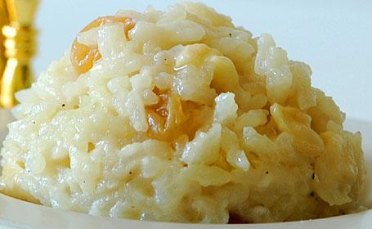
Uriel’s Sweet Rice

Slide 37
Ingredients:
Water
1 egg
1 spoon of butter
rice
sugar
milk (can be concentrated milk)
cinnamon
lemon peel
Method:
Put water in a pot
When the water is at a boil add the rice in; stir so the rice won’t stick at the bottom
Add the lemon peel
Take a bowl and put the milk and egg in it; beat together
Let the rice cook then take the lemon peel out
Add the milk and egg into the rice
Quickly stir
Add 1 spoon of sugar
Add 1 spoon of butter; stir until dissolved
Once the butter is dissolved put it in a bowl and add the cinnamon on top

Slide 38
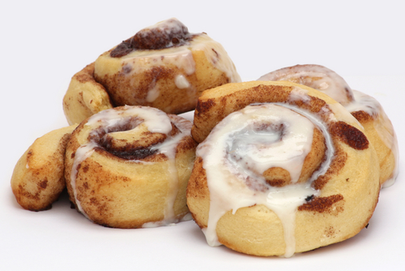
Tal’s Cinnamon Rolls

Slide 39
Ingredients:
Pastry Dough
25 grams of butter
¼ to ½ a cup of brown sugar
egg yolk (optional)
3 tbsp sugar powder
3 tbsp cinnamon
1-2 tbsp milk
Method:
Preheat oven to 150˚C
Cut a piece of dough into a rectangle (about 20 cm by 24 cm)
Melt the butter then add the brown sugar to it and mix well
Pour the mixture into a bowl
Spread onto the dough
The sprinkle cinnamon on top
Roll it length wise
Then cut it about 1 inch thick for every slice
Put on a baking pan and bake for 5 minutes
Mix the milk and powdered sugar together
Then add it on top of the cinnamon rolls

Slide 40
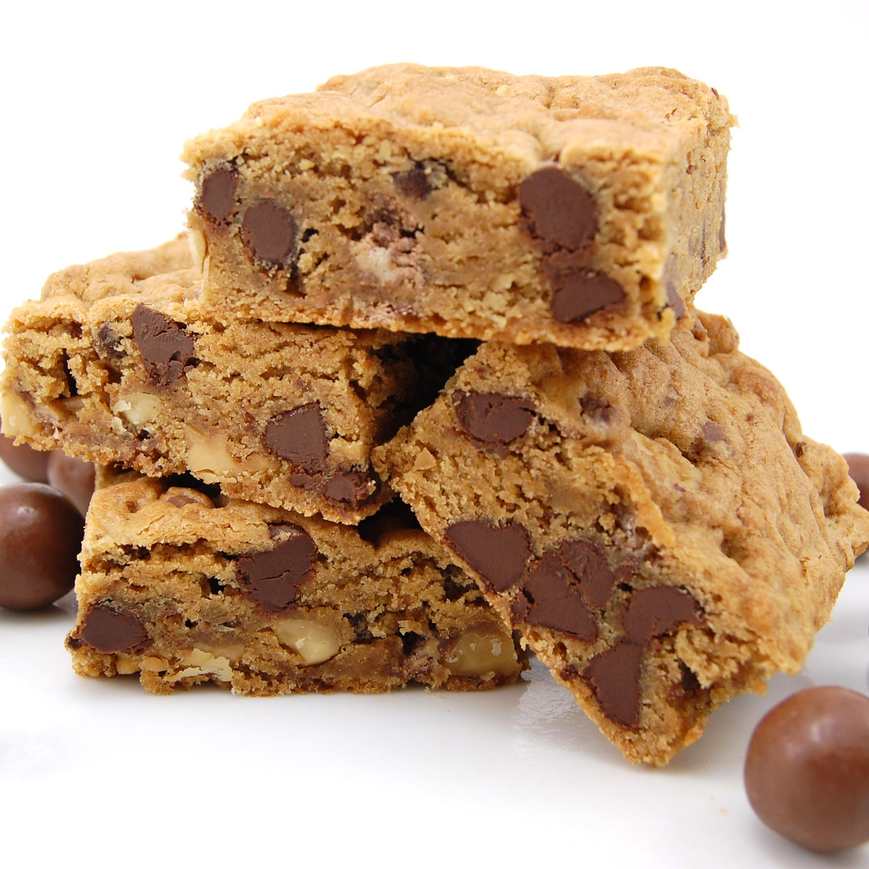
Evelyn’s Blondies

Slide 41
Ingredients:
1 cup flour
¼ tsp salt
½ cup unsalted butter
1 cup brown sugar
1 large egg
1 tsp vanilla extract
1 cup chocolate chips
Method:
Preheat oven to 180˚C
Grease your baking pan
Melt the butter in a large saucepan over low heat; then pour the butter into a medium bowl
Stir the brown sugar into the melted butter until it is dissolved
Quickly whisk in the egg and vanilla
Put the flour and salt into the butter mixture
Stir in the chocolate chips
Spread the batter into the baking pan and bake for 30-35 minutes

Slide 42
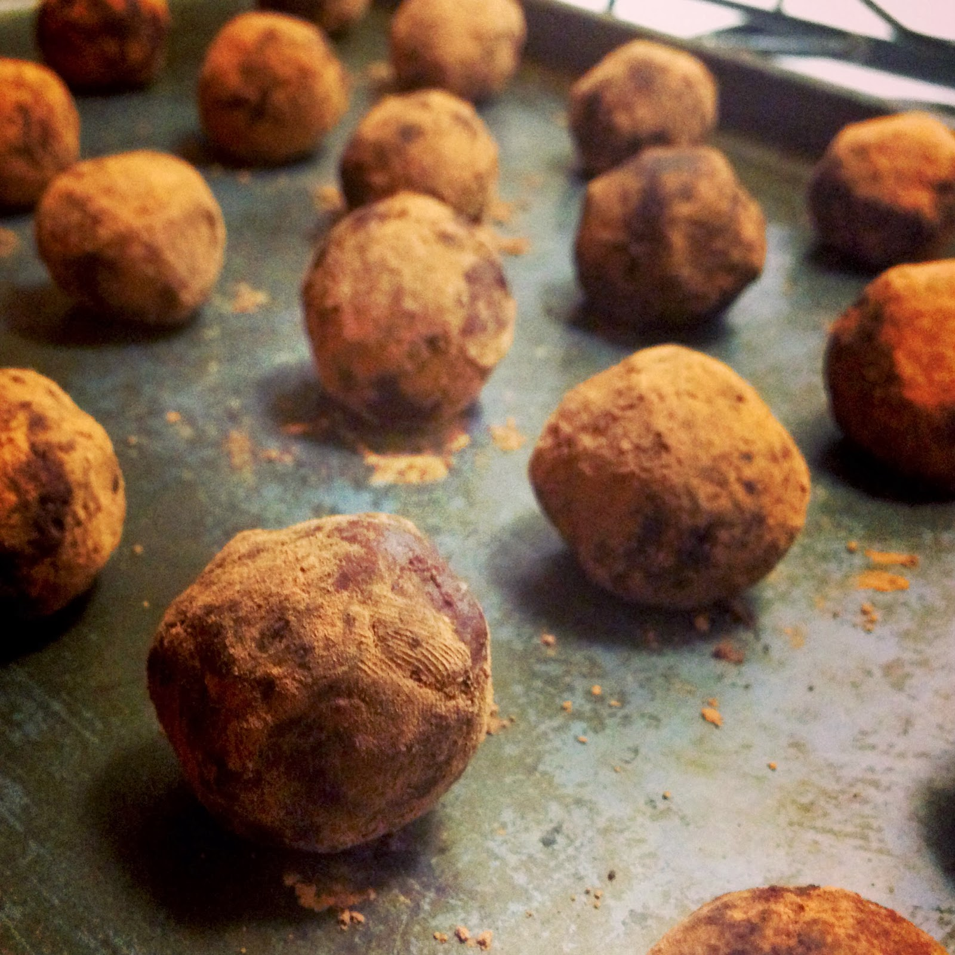
Ksenia’s Chocolate Potatoes

Slide 43
Ingredients:
3oo grams of cookies
2 tbsp of cocoa powder
3 tbsp of condensed milk
100 grams of butter
Method:
Crush the cookies in a food processor until they become crumbs; then place in a bowl
In another bowl add the cocoa powder, butter, and condensed milk; mix together with a fork
Mix the cookies into the bowl and mix with your hands
Take a handful of batter and create potato shapes
Roll the small potato shapes into some cocoa powder
Then put it in the fridge for a few minutes

Slide 44
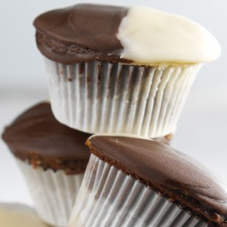
Csongor’s Black-and-White Cupcakes

Slide 45
Ingredients for Vanilla Batter:
8 tbsp (1 stick) unsalted butter, room temperature
1 ¾ cups all-purpose flour
2 tsp baking powder
½ tsp salt
¾ cup sugar
2 large eggs, room temperature
1 tsp vanilla extract
¾ cup whole milk
2 tbsp vegetable oil
Ingredients for Strawberry Whipped Cream:
0.5 L cream for whipping
1 sacket vanilla sugar
2 tbsp icing sugar
1 cup of strawberry puree
some mint leaves

Slide 46
Ingredients for Chocolate Batter:
8 tbsp (1 stick) unsalted butter, room temperature
1 ¼ cups all-purpose flour
½ cup unsweetened cocoa
2 tsp baking powder
½ tsp salt
¾ cup sugar
2 large eggs, room temperature
1 tsp vanilla extract
¾ cup whole milk
2 tbsp vegetable oil

Slide 47
Method: *Prepare both vanilla and chocolate batter fill muffin cups with 3 tablespoons of each, side by side
Preheat oven to 350 degrees
In a medium bowl, whisk together flour, baking powder, and salt; set aside
With an electric mixer, beat butter and sugar together until light and fluffy
Add oil then eggs one at a time, beating well after each addition; add vanilla, and mix until combined
On low speed, beat in half the flour mixture, followed by milk; end with remaining flour mixture: mix just until incorporated (do not overmix)
Divide batter among prepared muffin cups, filling each 2/3 full
Bake until a toothpick inserted in center of a cupcake comes out clean, 22 to 24 minutes
Cool cupcakes in pan for 5 minutes; then transfer to a wire rack to cool completely
Puree the strawberries with mint leaves and set aside
Whip the cream with sugar and add the puree
Frost the cupcakes with strawberry whipped cream

Slide 48
Citation
http://theshiksa.com/images/2010/01/Israeli-Salad1-640x480.jpg
http://blogs.mydevstaging.com/blogs/delish-dish/files/2013/02/frittata-by-cookie-and-kate-5.jpg
http://www.bonappetit.com/wp-content/uploads/2010/04/mare-pasta-al-pomodoro-h.jpg
http://3.bp.blogspot.com/-dF0C9tIm6H4/T7VZFPcSCfI/AAAAAAAABAQ/W10r-M-K5cY/s1600/shakshuka4.jpg
http://imworld.aufeminin.com/manage/bloc/D20110307/american-pancakes-1-123448_L.jpg
http://ribbitsandtiaras.files.wordpress.com/2013/01/couscous.jpg
http://www.blissfullydelicious.com/wp-content/uploads/2011/01/fried-mashed-potato-balls.jpg
http://picasso.media.s3.amazonaws.com/Meal%20Planning/Full%20Weekly%20Plan/630x300/Meal%20Plan%201/StirFry_fullweekly_630x300.jpg
http://1.bp.blogspot.com/-qxp0SILHRdU/UZAsNlvEOAI/AAAAAAAADgs/kpcFRU9FS3I/s1600/Tuna+Salad+Pret-a-vivre.com.JPG
http://www.eatdrinkandtravel.com/wp-content/uploads/2010/04/Empanada-Dough-450x299.jpg
http://www.angelfoods.com/photos/ParmCheeseSticks.jpg
http://www.lemontreepastriesnh.com/wp-content/uploads/tumblr_m32vmf0wM51rup70xo1_5001.jpg
http://photos-ak.sparkpeople.com/nw/2/8/l28775491.jpg
http://cinnybear.files.wordpress.com/2009/12/nutella-pound-cake.jpg
https://lh6.googleusercontent.com/-7Mu6KwW5Nz8/TYO2ZNTKi8I/AAAAAAAAED0/-LUEEMr5g4U/s1600/hamantaschen.jpg
http://www.nandyala.org/mahanandi/images/paramannam/sweetriceimagecopyrighted.jpg
http://skyranch.org/wp-content/uploads/2013/02/cinnamon-rolls.jpg
http://sweetpeaskitchen.files.wordpress.com/2010/11/dsc_0792.jpg
http://2.bp.blogspot.com/-T8Irf0jv2ow/UvBMZmyWI2I/AAAAAAAABEw/xc2ws6X9rCA/s1600/chocolate+sweet+potato+truffles.JPG
http://slevyfoods.com/wp-content/uploads/2013/02/B.WCupcakesFinal.24.jpg
https://dockfam.files.wordpress.com/2014/01/cooking-clipart24-cooking-clip-art-cooking-clip-art-5-best-clip-art-blog-zlh6dqh7.jpg?w=360&h=280
http://photos1.blogger.com/blogger/2659/2048/320/garfield.jpg

